Slide 1
Cloud Computing
SEWP ZG527

Slide 2
High Availability
High availability (HA) is the elimination of single points of failure to enable applications to continue to operate even if one of the IT components it depends on, such as a server, fails. IT professionals eliminate single points of failure to ensure continuous operation and uptime.
Highly Available Systems Incorporate Five Design Principles:
They automatically failover to a redundant system to pick up an operation when an active component fails. This eliminates single points of failure.
They can automatically detect application-level failures as they happen, regardless of the causes.
They ensure no amount of data loss during a system failure.
They automatically and quickly failover to redundant components to minimize downtime.
They provide the ability to manually failover and failback to minimize downtime during planned maintenance.
Notes:
RL 7.1

Slide 3
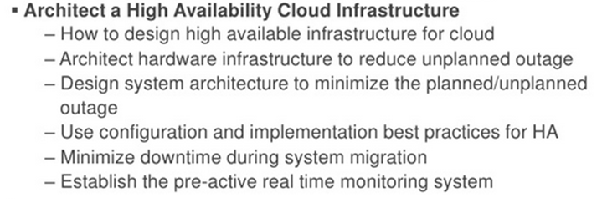
High Availability
Steps to achieve high availabilty
Build for server failure
Build for zone failure
Build for Cloud failure
Automating and testing

Slide 4
High Availability
The following elements help you implement highly available systems:
Redundancy—ensuring that critical system components have another identical component with the same data, that can take over in case of failure.
Monitoring—identifying problems in production systems that may disrupt or degrade service.
Failover—the ability to switch from an active system component to a redundant component in case of failure, imminent failure, degraded performance or functionality.
Failback—the ability to switch back from a redundant component to the primary active component, when it has recovered from failure.
Notes:
http://www.rightscale.com/blog/enterprise-cloud-strategies/four-steps-achieving-high-availability-cloud

Slide 5
High Availability
What is difference between availability and reliability a cloud?
Availability in cloud computing ensures that products, services and tools are available to customers at any given point of time and is measured by downtimes of overall cloud services.
Reliability, however, measures the probability that the cloud services are delivered exactly what they are meant for
High Availability Metrics: RTO and RPO
The two metrics normally used to assess HA as well as disaster recovery (DR) are the recovery time objective (RTO) and the recovery point objective (RPO).
RTO is the maximum tolerable duration of any outage. Online transaction processing applications generally have the lowest RTOs, and those that are essential often have an RTO of only a few minutes.
RPO is the maximum amount of data loss that can be tolerated when a failure happens. For HA, RPO is often zero to specify there should be zero data loss under all failure scenarios.
Notes:
RL 7.1

Slide 6
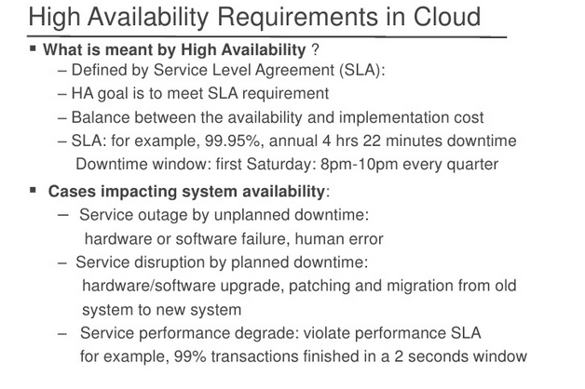
High Availability
Notes:
RL 7.1

Slide 7
High Availability
Availability (also known as service availability) is both a commonly used metric to quantitatively measure resiliency, as well as a target resiliency objective.
Availability is the percentage of time that a workload is available for use.
Available for use means that it performs its agreed function successfully when required. This percentage is calculated over a period of time, such as a month, year, or trailing three years. Applying the strictest possible interpretation, availability is reduced anytime that the application isn’t operating normally, including both scheduled and unscheduled interruptions.
We define availability as follows:
• Availability is a percentage uptime (such as 99.9%) over a period of time (commonly a month or year) • Common short-hand refers only to the “number of nines”; for example, “five nines” translates to being 99.999% available
• Some customers choose to exclude scheduled service downtime (for example, planned maintenance) from the Total Time in the formula.
However, this is not advised, as your users will likely want to use your service during these times.
Availability=Availability of Use time/ Total Time
Notes:
http://www.rightscale.com/blog/enterprise-cloud-strategies/four-steps-achieving-high-availability-cloud

Slide 8
High Availability
Calculating availability with hard dependencies.
Many systems have hard dependencies on other systems, where an interruption in a dependent system directly translates to an interruption of the.
. Where such hard dependencies occur, the invoking system’s availability is the product of the dependent systems’ availabilities.
For example, if you have a system designed for 99.99% availability that has a hard dependency on two other independent systems that each are designed for 99.99% availability, the workload can theoretically achieve 99.97%
availability: Availinvok × Availdep1 × Availdep2
= Availworkload 99.99% × 99.99% × 99.99% = 99.97%
It’s therefore important to understand your dependencies and their availability design goal
Notes:
http://www.rightscale.com/blog/enterprise-cloud-strategies/four-steps-achieving-high-availability-cloud

Slide 9
High Availability Calculation
Calculating availability with redundant components.
When a system involves the use of independent, redundant components (for example, redundant resources in different Availability Zones),
the theoretical availability is computed as 100% minus the product of the component failure rates.
For example, if a system makes use of two independent components, each with an availability of 99.9%, the effective availability of this dependency is 99.9999%: Availeffective = AvailMAX − ((100%−Availdependency)×(100%−Availdependency)) 99.9999% = 100% − (0.1%×0.1%)
Shortcut calculation: If the availabilities of all components in your calculation consist solely of the digit nine, then you can sum the count of the number of nines digits to get your answer. In the above example two redundant, independent components with three nines availability results in six nines.
Calculating dependency availability.
(for example, a component where the manufacturer does not publish availability information), one way to estimate is to determine the Mean Time Between Failure (MTBF) and Mean Time to Recover (MTTR). An availability estimate can be established by: For example, if the MTBF is 150 days and the MTTR is 1 hour, the availability estimate is 99.97%
Notes:
http://www.rightscale.com/blog/enterprise-cloud-strategies/four-steps-achieving-high-availability-cloud

Slide 10
AWS High Availability
AWS high availability architecture
AWS has a global infrastructure to provide high availability for cloud workloads. The key components of this architecture include:
Regions—21 geographical zones each containing at least three availability zones.
Availability zones—66 global zones, which are self-sufficient data centers with redundant power, networking and cooling. Deploying across several AZs can protect your applications and provide you with resiliency in case failures occur.
Compliance and data residency—Amazon provides full control over AWS regions to help you comply with data sovereignty requirements.
Notes:
RL 7.1

Slide 11
AWS High Availability
Advantages of Using AWS High Availability for Web Applications
AWS high availability for web applications provides you with the following benefits:
A completely secured network that uses a Web Application Firewall (WAF) to prevent common web exploits.
AWS HA has provisions like Business Continuity (BC) and Disaster Recovery (DR) technologies to help businesses resume operations with minimal disruption.
For cases where instant hardware failure may arise or are about to arise, AWS Auto Scaling automatically detects this and launches a new instance.
AWS HA provides metrics on the cloud to closely monitor the application based on the number of users using the application or the memory consumed by the particular instance.
The deployment of new features or updates may be done without causing any problems for present users.
Notes:
RL 7.1

Slide 12
AWS High Availability
AWS High Availability for Storage Services
Here is a brief summary of the high availability capabilities Amazon offers for other popular storage services:
Amazon S3 S3 guarantees 99.999999999% (twelve 9’s) durability, by redundantly storing objects on multiple devices across a minimum of three AZs in an Amazon S3 Region.
Amazon EFS EFS guarantees 99.9% availability, otherwise between 10-100% of the service fee is discounted. Every file system object is redundantly stored across multiple AZs.
Amazon EBS EBS volumes are created in a specific AZ. You can make a volume available in another AZ and it can then be attached to other instances in that same Availability Zone. To make a volume available outside the AZ, or to create redundancy, you can create a snapshot and restore it in another AZ within the same region. You can also copy snapshots to other AWS regions, to create redundancy across Amazon data centers.
Notes:
RL 7.1

Slide 13
AWS High Availability
AWS Regions and High Availability Zones
Amazon hosts its web services across multiple locations, with each AWS location consisting of multiple availability zones and availability ranging from 99.9% to 99.999%.
Each AWS Region runs in complete autonomy. This ensures the greatest level of fault tolerance and stability for user and application workloads.
All AWS Availability Zones (AZs) are configured to operate in such a way that they are able to provide inexpensive, low latency network connectivity to other Availability Zones in the same region as well. These are connected to multiple Internet Service Providers (ISPs) and different power grids.
Your application(s) can be safeguarded against failure in a single data center by deploying EC2 instances in various Availability Zones.
It is important to run independent application stacks in more than one Availability Zone, either in the same region or in another region, so that if one zone fails, the application in the other zone can continue to run.
Notes:
RL 7.1

Slide 14
High Availability
The following elements help you implement highly available systems:
Redundancy—ensuring that critical system components have another identical component with the same data, that can take over in case of failure.
Monitoring—identifying problems in production systems that may disrupt or degrade service.
Failover—the ability to switch from an active system component to a redundant component in case of failure, imminent failure, degraded performance or functionality.
Failback—the ability to switch back from a redundant component to the primary active component, when it has recovered from failure.
AWS helps you achieve high availability for cloud workloads, across three different dimensions:
Compute—Amazon EC2 and other services that let you provision computing resources, provide high availability features such as load balancing, auto-scaling and provisioning across Amazon Availability Zones (AZ), representing isolated parts of an Amazon data center.
SQL databases—Amazon RDS and other managed SQL databases provide options for automatically deploying databases with a standby replica in a different AZ.
Storage services—Amazon storage services, such as S3, EFS and EBS, provide built-in high availability options. S3 and EFS automatically store data across different AZs, while EBS enables deployment of snapshots to different AZs.
Notes:
RL 7.1

Slide 15
High Availability
AWS Services Used to Achieve High Availability
AWS delivers high availability through a scalable, load-balanced cluster or an active-standby pair, among other approaches. The majority of Amazon Web Services are designed to be fault-tolerant and have high availability. The following list includes some of them:
Amazon S3
Amazon Relational Database (RDS)
Amazon Simple Queue Service (SQS)
Elastic Load Balancing (ELB)
Amazon Simple Notification Service (SNS)
Amazon Virtual Private Cloud (VPC)
Amazon Machine Engine (AMI)
Notes:
RL 7.1

Slide 16
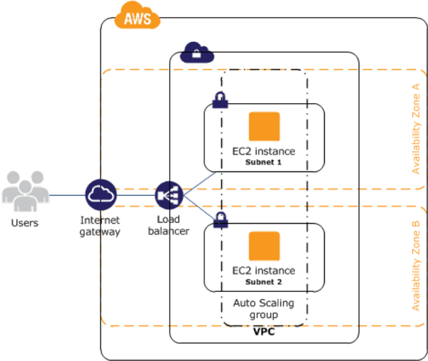
High Availability
AWS High Availability for EC2 Instances
If you are running instances on Amazon EC2, Amazon provides several built-in capabilities to achieve high availability:
Elastic Load Balancing—you can launch several EC2 instances and distribute traffic between them.
Availability Zones—you can place instances in different AZs.
Auto Scaling—use auto-scaling to detect when loads increase, and then dynamically add more instances.
Notes:
RL 7.1

Slide 17
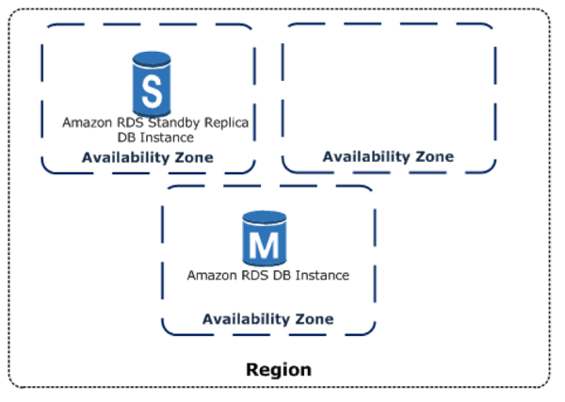
High Availability
AWS High Availability for SQL Databases on Amazon RDS
RDS provides high availability using Multi-Availability Zone (Multi-AZ) deployments. This means RDS automatically provisions a synchronous replica of the database in a different availability zone. When the main database instance goes down, users are redirected transparently to the other availability zone.
This provides two levels of redundancy:
In case the active database fails, there is a standby replica ready to receive requests
In case of a disruption in the AZ your main database instance is running in, there is failover to another AZ.
Notes:
RL 7.1

Slide 18
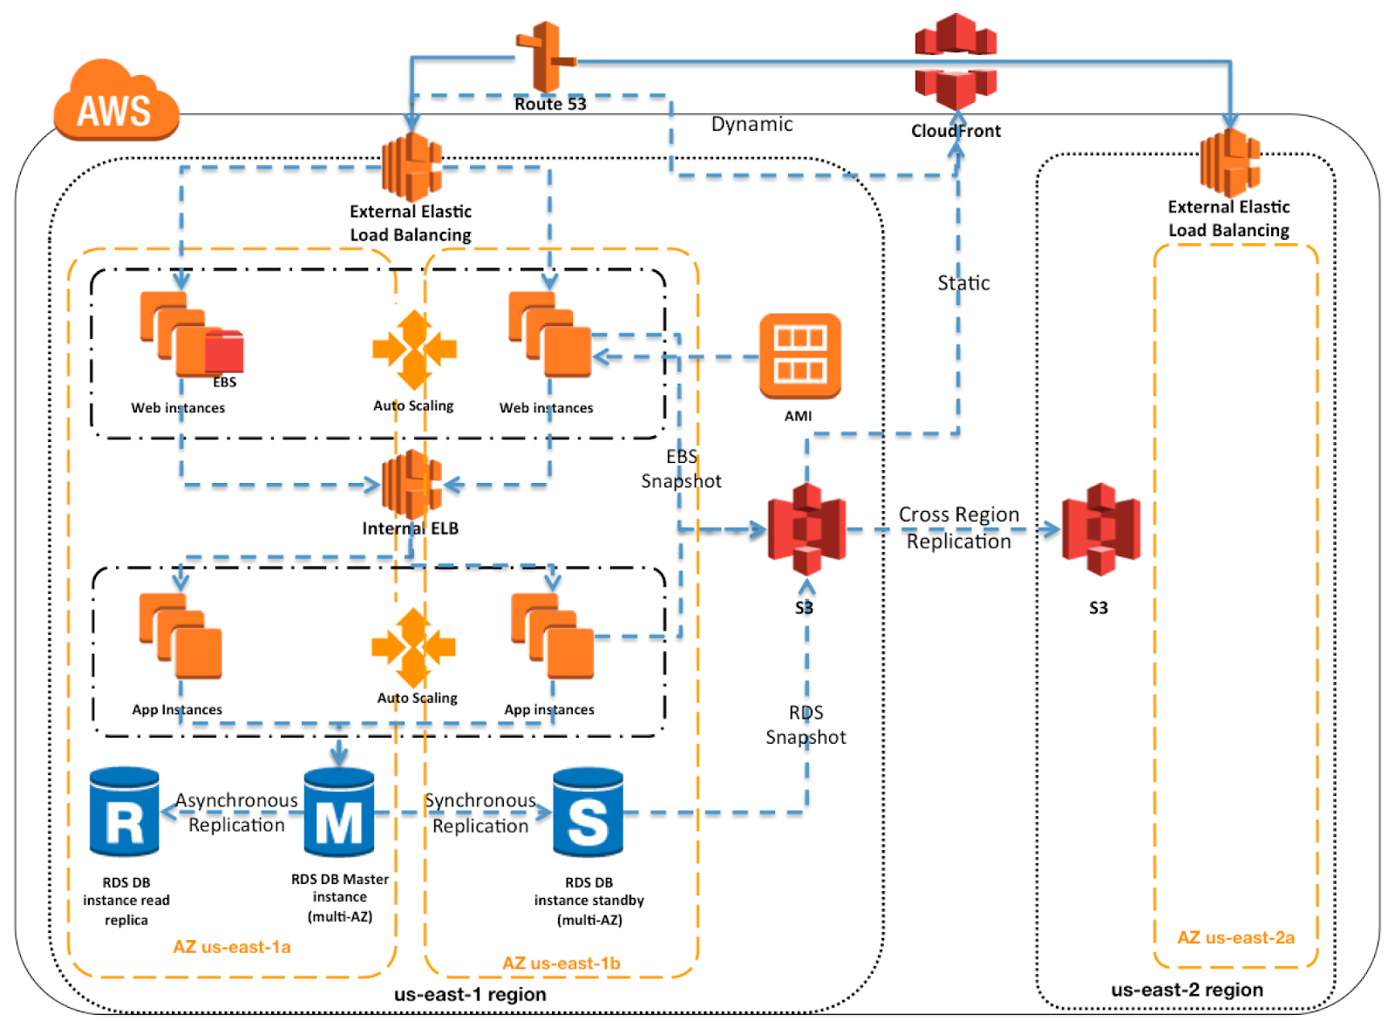
High Availability
Notes:
RL 7.1

Slide 19
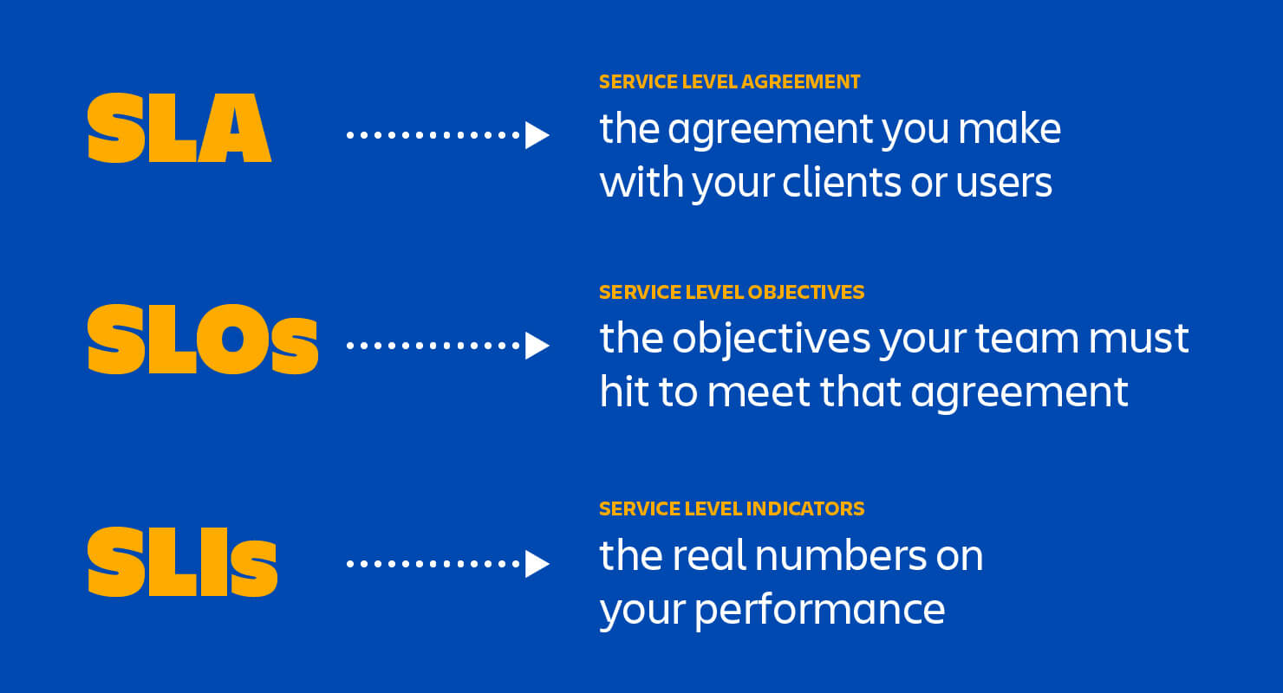
What is SLA, SLO and SLI

Slide 20
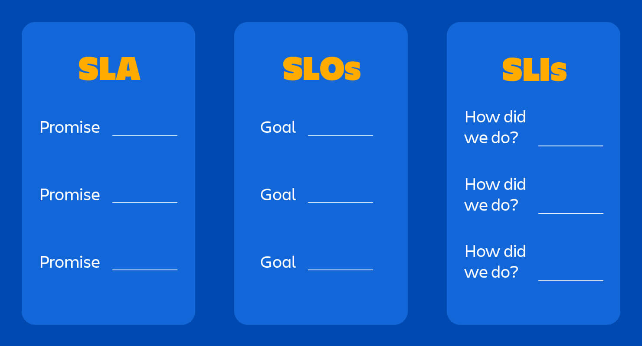
SLA, SLO and SLI Goal

Slide 21
What Is An SLA?
SLA stands for the “service-level agreement.” It is an agreement between a party that offers some service(s) and users of those service(s). The contract includes the list of services and highlights the quality standards that the provider should follow to guarantee customer satisfaction. The contract also recalls the ways to redress gaps and problems (e.g., using service credits).
What Should Service Level Agreement Include:
Detailed service overview
Speed of service delivery
Plan for performance monitoring
Description of the reporting procedure
List of penalties that will be applied in case of agreement violations
Constraints

Slide 22
What is SLO and SLI
An SLO (service level objective) is an agreement within an SLA about a specific metric like uptime or response time. So, if the SLA is the formal agreement between you and your customer, SLOs are the individual promises you’re making to that customer. SLOs are what set customer expectations and tell IT and DevOps teams.
An SLI (service level indicator) measures compliance with an SLO (service level objective). So, for example, if your SLA specifies that your systems will be available 99.95% of the time, your SLO is likely 99.95% uptime and your SLI is the actual measurement of your uptime. Maybe it’s 99.96%. Maybe 99.99%. To stay in compliance with your SLA, the SLI will need to meet or exceed the promises made in that document.

Slide 23
What Is An SLA?
What Is An SLA Model?
To understand that, one may need to know the performance metrics that are usually involved:
Availability & uptime percentage
Various performance benchmarks
Response time (often associated with the work of customer service)
Problem resolution time
Usage statistics that will be provided

Slide 24
SLA Types
SLA is usually divided into 3 categories. They are:
Customer-based SLA
This type of SLA is intended for individual customers and includes all services they request. The document covers details about service quality to let customers know what level of service delivery they should expect. A good example could be telecommunication companies. Their services contain messaging, Internet connection, and voice calls. However, all of them fall under just one agreement.
Service-oriented SLA
This document presents a single identical service for all clients. It is based on a single set of standards which makes this type of SLA the most convenient one. For instance, users sign the service level agreement regarding information technologies helpdesk. That means that the same service is valid for all users.
Multi-level SLA
This agreement is based on requests from end-user companies. It’s a customizable contract that makes it possible to play with various standards and conditions to make both sides benefit from the final version of the document. This type of SLA can be divided into subcategories.
Corporate: No frequent updates are needed for such an agreement. The points included in the contract usually remain unaltered. The document of this type is applicable to all customers of the company.
Client: Such an agreement covers all service aspects related to a certain category of customers. At the same time, the type of services is not considered.
Service: This document involves all factors attributed to a specific service regarding a certain group of customers.

Slide 25
What makes a good SLA?
A well thought out content. Here are six components necessary for a good agreement:
Document overview
This involves checking main points listed in the agreement: individuals involved, start and expiration dates and other details.
Strategic goals
Description of the agreement purpose and objectives.
Shareholders
A list of all parties and individuals involved in the contract.
Regular review and necessary changes
This section demonstrates a requirement for systematic review and conditions upon which modifications can be made.
Service agreement
This section covers customer and provider requirements, service scope and service assumptions.
Service management
Includes information about service delivery and availability.

Slide 26
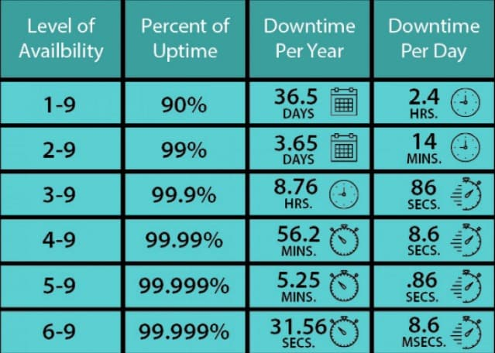
service delivery and availability.

Slide 27
What professional SLA management services
What professional SLA management services should include:
Setting realistic conditions that a service provider can ensure;
Meeting the needs and requirements of the clients;
Establishing the right metrics for evaluating the performance of the services;
Ensuring compliance with the terms and conditions agreed with the clients;
Avoiding any violations of SLA terms and conditions.
An SLA is a preventive means that allows establishing a transparent relationship between both parties involved and increases confidence in the cooperation. Such a document is fundamental to a successful collaboration between a client and a service provider.

Slide 28
Types Of SLA Penalties
A natural reply to any kind of violation is penalty. An SLA penalty depends on the industry and business. Let’s take a look at the two most common SLA penalty types.
1. Financial penalty
This kind of penalty requires a vendor to pay the customer a compensation of damages equal to the one written in the agreement. The amount will depend on the extent of a violation and damage and may not be a full reimbursement of what a customer paid for the ecommerce service or ecommerce support.
2. Service credit
In this case a service provider will reimburse the customer in the form of service credits which a client can use for future projects. In other words, a vendor will have to provide a customer with free services for a specific time period.
To avoid any confusion or misunderstanding between the two parties in case of SLA violation such penalties must be clearly articulated in the agreement. Otherwise, they won’t be legitimate. The conditions of paying off the compensation should be stated explicitly and in details without leaving any room for discussion.
What are the differences between SLA and KPI?
It is common for some people to mix SLA and KPI, but they are two very different concepts. In short, companies build an SLA to ensure complying services until the end of the contract. KPIs, on the other hand, are performance indicators aimed at measuring actions already taken.
Thus, the SLA anticipates what may happen and tries to ensure that everything goes well, while the KPI brings predefined indicators to measure the results of the actions put into practice.

Slide 29
What are the best SLA practices?
Set an average response time for problem-solving
When a client calls your business because of a problem, the teams in charge need to perform a quick response time. After all, the longer the problem persists, the bigger the delays and damages to work.
when defining your SLA, consider potential problems and the average time it takes to solve them. This way, everyone will have the right expectation about response time.
Use neutral language between the parties
It is important to use terms that are clear and simple for everyone to understand. Even if you are able to understand what your IT manager says, particular words may be difficult to understand for your clients and even colleagues at the company. In this context, neutral language is key to ease communication.
Simplify the creation of SLAs
Instead of creating long and complex SLAs, set simple and shorter versions, so you can analyze their flow and the customer can understand them. This action makes the workflow more appropriate to optimize each task your team must do.
Define which tickets have higher priority
Imagine that, during a work shift, one of the headsets stops working in an important call and the CRM access goes down. Your IT manager will receive two tickets at the same time. So which one to prioritize?
Answering this question requires you to define the different ticket priorities in advance, as the weight can be higher or lower depending on the circumstance.
In the example above, access to the CRM would be a higher priority because it affects everyone’s work, while the damaged headset concerns only one person. However, if the call is to talk to a customer who is about to churn, that priority might be higher.

Slide 30
What are the best SLA practices?
Determine days and times for SLA tasks
A customer may get frustrated when they contact you and do not get a response. But what if they made contact on a Saturday midnight instead of Monday through Friday business hours?
If your company operates Monday through Friday during business hours, it has to be clear in the SLA. This way, customers are aware that your team will only perform tasks and requests during the given days and times.
On the other hand, if the service is outsourced and provides 24/7 support, it is still essential to insert in the contract what types of services are provided during and outside business hours. This way, customers and everyone inside the company know what to expect.

Slide 31
Key aspects of SLA
cloud service provider. Service level agreements usually specify certain parameters, which are mentioned below:
Availability of the Service (uptime)
Latency or the response time
Service components reliability
Each party accountability
Warranties

Slide 32
Types of SLA
What are the three types of SLAs? There are three basic types of SLAs:
customer, internal and multilevel service-level agreements.
A customer service-level agreement is between a service provider and its external customers
The main elements of a good SLA.
Overall objectives. The SLA should set out the overall objectives for the services to be provided
Description of the Services. The SLA should include a detailed description of the services
Performance Standards
Compensation/Service Credits.
Critical Failure
.

Slide 33
SLA
The importance of a cloud SLA
Service-level agreements are fundamental as more organizations rely on external providers for their critical systems, applications and data.
A cloud SLA ensures cloud providers meet certain enterprise-level requirements and provide customers with a clearly defined set of deliverables. It also describes financial penalties, such as credits for service time, if the provider fails to live up to the guaranteed terms.
Cloud service-level agreements may be more detailed to cover governance, security specifications, compliance, and performance and uptime statistics. They should address security and encryption practices for data protection and data privacy, disaster recovery expectations, data location, as well as data access and portability.

Slide 34
Key aspects of SLA
Typically, the service-level objectives (SLOs) for these applications were response time and throughput of the application end-user requests.
The capacity buildup was to cater to the estimated peak load experienced by the application. The activity of determining the number of servers and their capacity that could satisfactorily serve the application end-user requests at peak loads is called capacity planning

Slide 35
Key aspects of SLA
What is an SLI?
An SLI, or Service Level Indicator, measures how well a company actually meets the SLO promises that it sets within SLAs.
For instance, if you promise an SLO of 99.9 percent uptime, and you achieve 99.95 percent uptime, then your SLI would be 99.95 percent (and you’d be exceeding your SLO, which is good).
Tracking SLIs is important for two main reasons. The most obvious is that demonstrating SLIs to customers allows companies to show that they are meeting the terms of an SLA.
Second, by tracking SLIs on a continuous basis, vendors can detect when they are falling short of meeting SLO promises, and they can take measures to address the problem before it turns into an SLA violation. Given that SLOs are often made on the basis of meeting certain goals over a period of time, early detection of SLI issues makes it possible to correct those issues before they persist long enough to trigger SLO non-compliance.
Similarities and differences between SLAs, SLOs and SLIs
SLAs, SLOs and SLIs share one major thing in common: They are all part of the formal process that businesses use to set and track reliability, performance and availability goals. By extension, they are central to the work performed by SREs, whose main job is to help businesses meet the goals they set within these categories.
However, once you dive into the details, SAs, SLOs and SLIs are clearly different types of entities:
An SLA is a contract.
An SLO is a specific goal that is defined in a contract.
An SLI measures the extent to which teams comply with the SLO promises they make in SLA contracts.

Slide 36
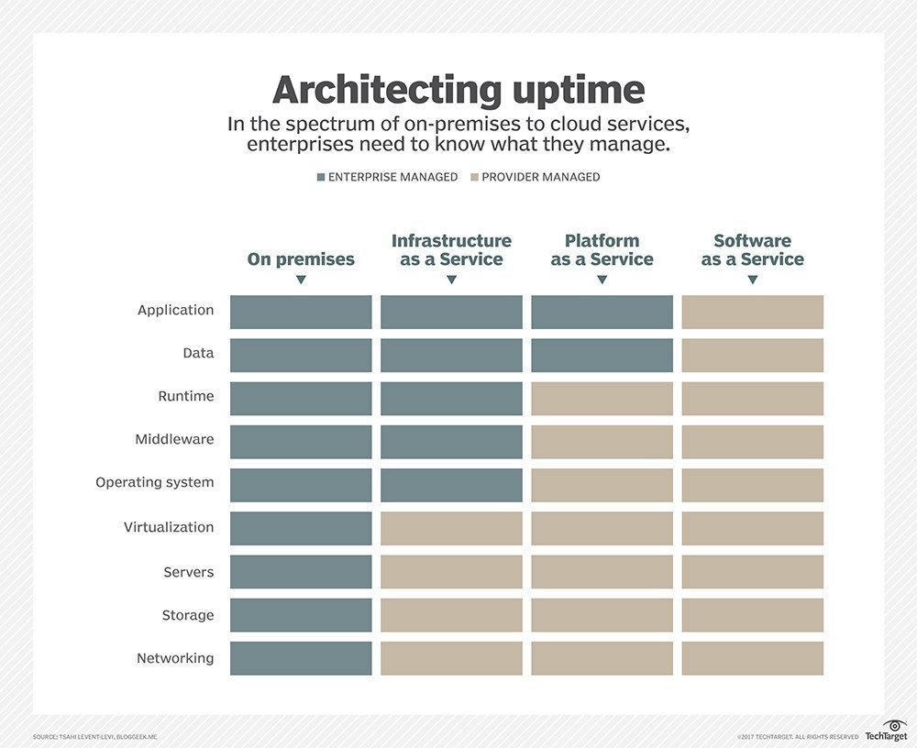
SLA, SLO and SLI

Slide 37
Key aspects of SLI
An SLI, or Service Level Indicator, measures how well a company actually meets the SLO promises that it sets within SLAs.
For instance, if you promise an SLO of 99.9 percent uptime, and you achieve 99.95 percent uptime, then your SLI would be 99.95 percent (and you’d be exceeding your SLO, which is good).
Tracking SLIs is important for two main reasons. The most obvious is that demonstrating SLIs to customers allows companies to show that they are meeting the terms of an SLA.
Second, by tracking SLIs on a continuous basis, vendors can detect when they are falling short of meeting SLO promises, and they can take measures to address the problem before it turns into an SLA violation. For example, if an incident disrupts your application’s availability and you can resolve the incident quickly with the help of an incident management platform, you can fix the problem before it results in enough downtime to cause you to fall short of your SLO promises.
Given that SLOs are often made on the basis of meeting certain goals over a period of time, early detection of SLI issues makes it possible to correct those issues before they persist long enough to trigger SLO non-compliance.

Slide 38
Benefits of service level management
What is service level management?
Service level management means ensuring that all processes and operational agreements for the level of services provided to customers are appropriate.
It includes monitoring and reporting on service levels, setting and adjusting SLOs, determining SLIs, making sure you are meeting SLAs, and holding customer reviews.
The central focus really is the shared meaning of “availability” across teams, in your SLOs, also captured in the SLAs with your customers. To make sure your business is meeting or exceeding these service level agreements, it’s important for cross-functional teams to manage internal SLOs.

Slide 39
Benefits of service level management
Good practices for SLIs, SLOs, and SLAs, and a platform for your service level management, bring these benefits:
Easy setup: Automatically establish a baseline of performance and reliability for any service with a one-click setup and recommendations and customizations provided in a simple, guided flow.
Define reliability across teams: Avoid arduous alignment processes with SLO and SLI recommendations that help you determine service boundaries. Set reliability benchmarks automatically based on recent performance metrics in any entity.
Iterate and improve: With full-stack context and teams have insight into how specific nodes or services impact system reliability and can quickly take control over their performance. Custom views for both service owners and business leaders drive operational efficiency and lead to better reporting, alerting, and incident management processes.
Standardize reliability: Cross-organizational teams have a unified, transparent view of service reliability, and can better comply with customer-facing SLAs. SLO compliance metrics and error budgets give organizations a way to report on reliability and implement changes across applications, infrastructure, and teams in a cohesive fashion.

